Slide 1



FOR INTERNAL USE ONLY

Slide 2
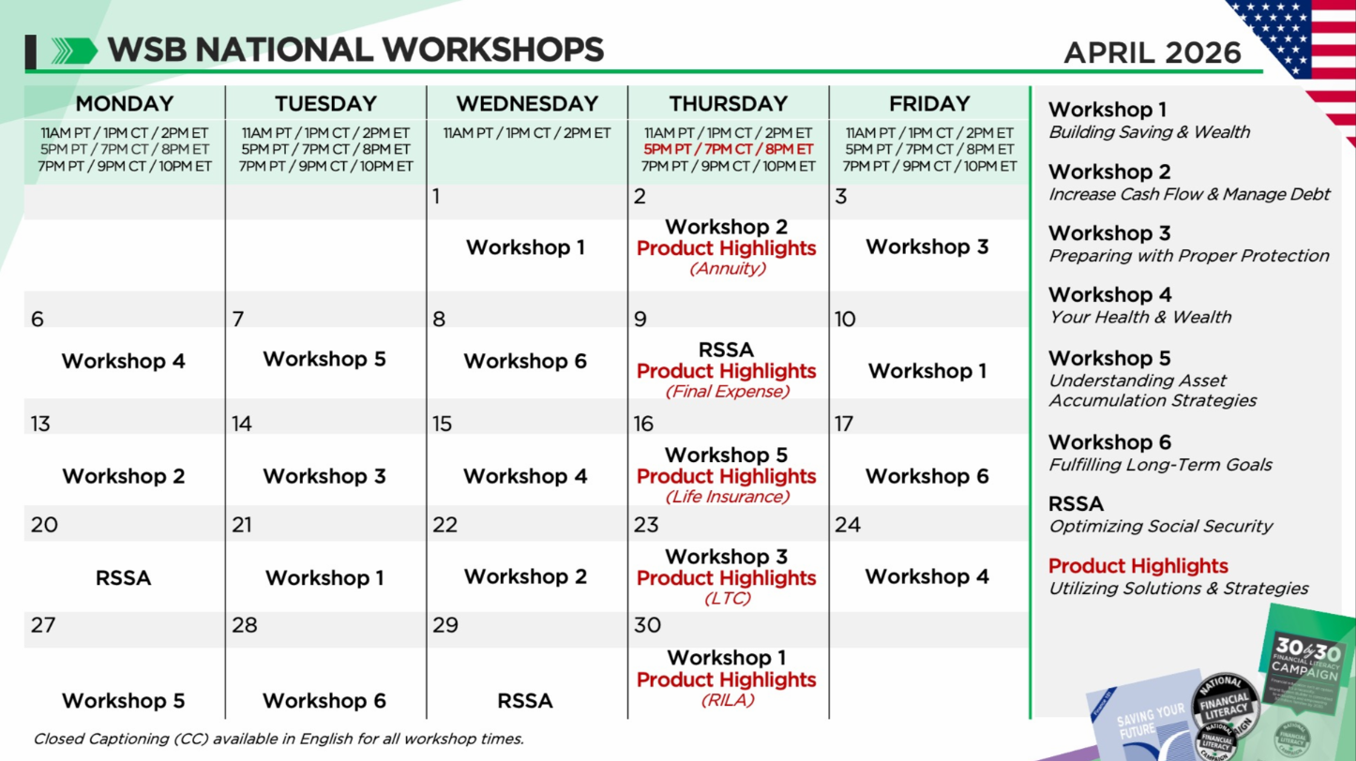
HOW WE DO IT: FINANCIAL EDUCATION
FOR INTERNAL USE ONLY

Slide 3
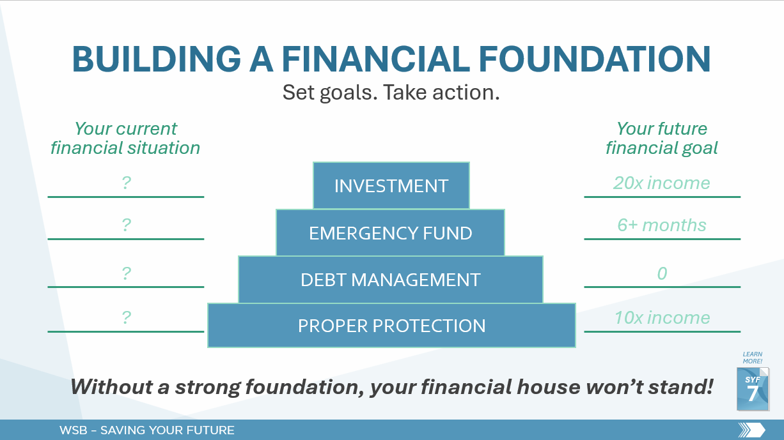
FOR INTERNAL USE ONLY
FOR INTERNAL USE ONLY

Slide 4
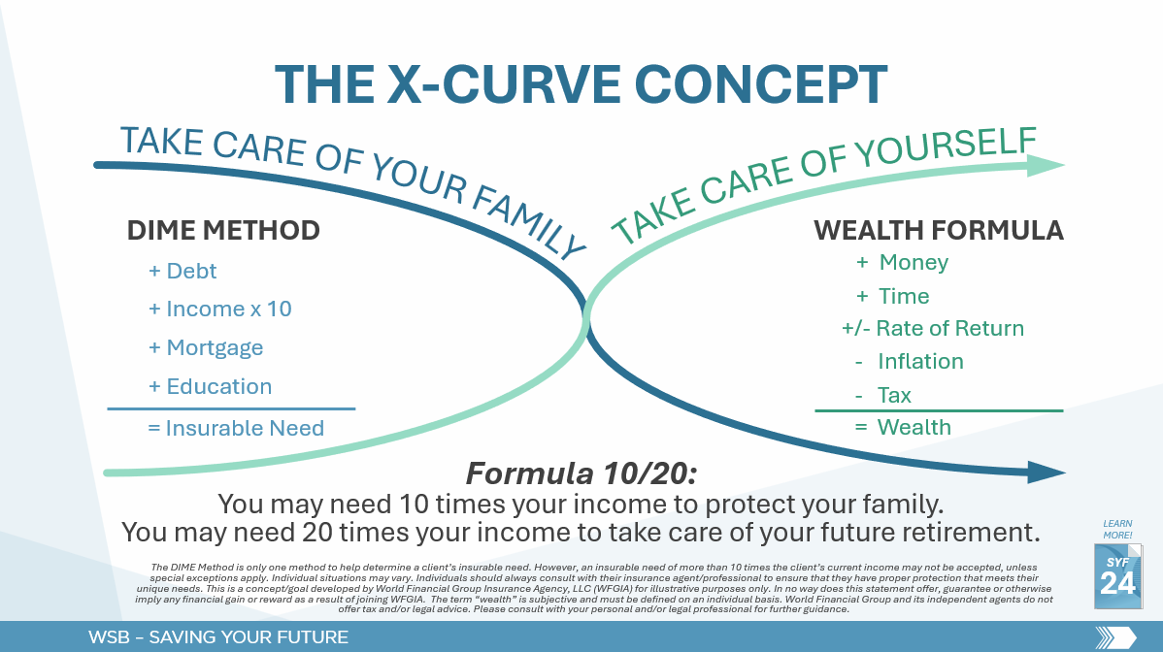
FOR INTERNAL USE ONLY
FOR INTERNAL USE ONLY

Slide 5
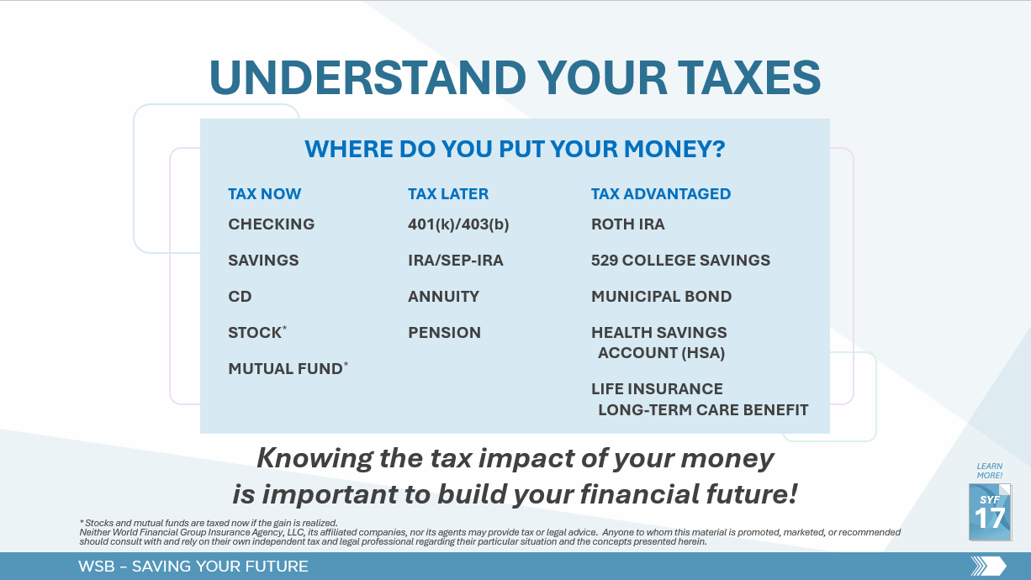
FOR INTERNAL USE ONLY
FOR INTERNAL USE ONLY

Slide 6


Slide 7
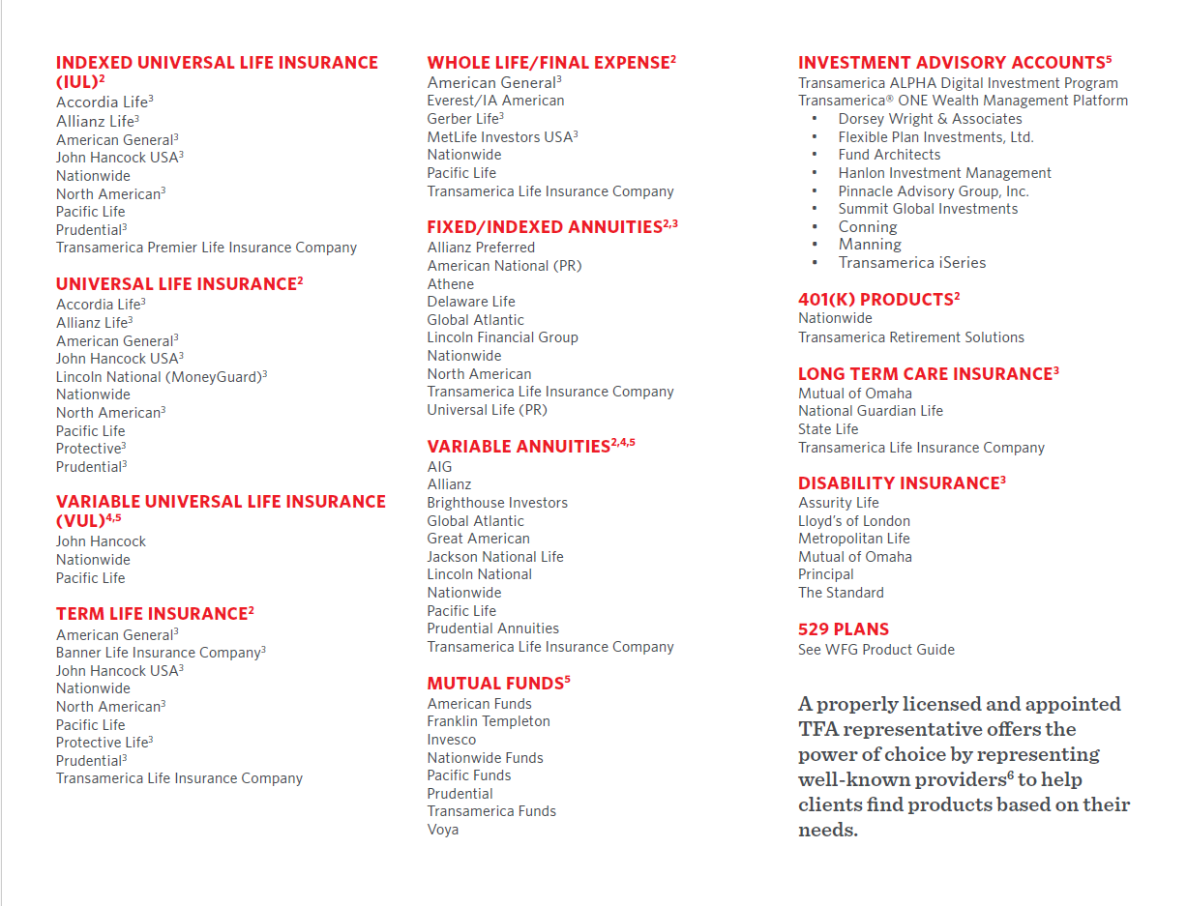
FOR INTERNAL USE ONLY

Slide 8
UITs
UNIT INVESTMENT TRUSTS
FOR INTERNAL USE ONLY

